Slide 1

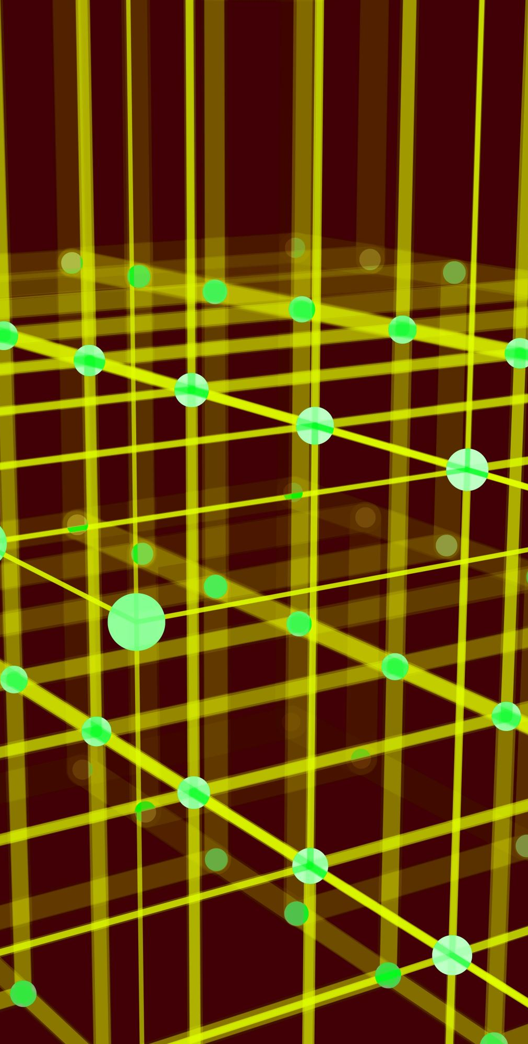
Unit 3
Knowledge Representation

Slide 2
Disclaimer
Some contents in this presentation are retrieved from the following original sources:
1. Washington State University: Artificial Intelligence Course
2. Introduction to Articial Intelligence by Prof. Bojana Dalbelo Basic and Assoc. Prof. Jan Snajder, University of Zagreb, Faculty of Electrical Engineering and Computing
3. https://www.educba.com/intelligent-agents/
4. https://www.geeksforgeeks.org/artificial-intelligence-an-introduction/

Slide 3
Knowledge Representation
When we use search to solve a problem we must
Capture the knowledge needed to formalize the problem
Apply a search technique to solve problem
Execute the problem solution

Slide 4
Role of KR
The first step is the role of “knowledge representation” in AI.
Formally,
The intended role of knowledge representation in artificial intelligence is to reduce problems of intelligent action to search problems.
A good description, developed within the conventions of a good KR, is an open door to problem solving
A bad description, using a bad representation, is a brick wall preventing problem solving

Slide 5
A Knowledge-Based Agent
We previously talked about applications of search but not about methods of formalizing the problem.
Now we look at extended capabilities to general logical reasoning.
Here is one knowledge representation: logical expressions.
A knowledge-based agent must be able to
Represent states, actions, etc.
Incorporate new percepts
Update internal representations of the world
Deduce hidden properties about the world
Deduce appropriate actions
We will
Describe properties of languages to use for logical reasoning
Describe techniques for deducing new information from current information
Apply search to deduce (or learn) specifically needed information

Slide 6
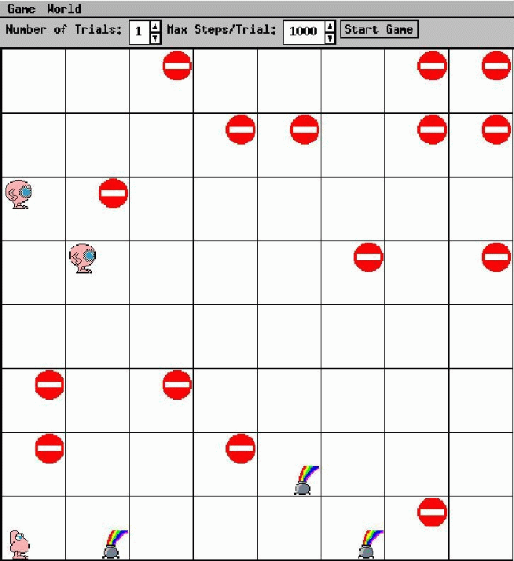
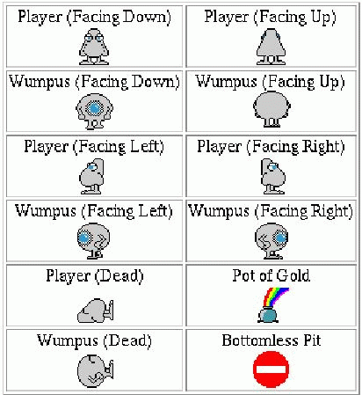
The Wumpus World Environment

Slide 7
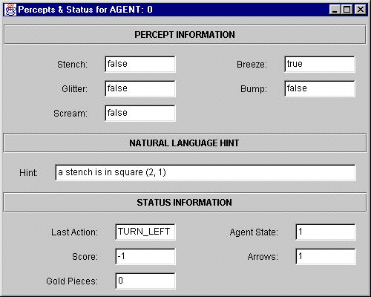
Percepts

Slide 8
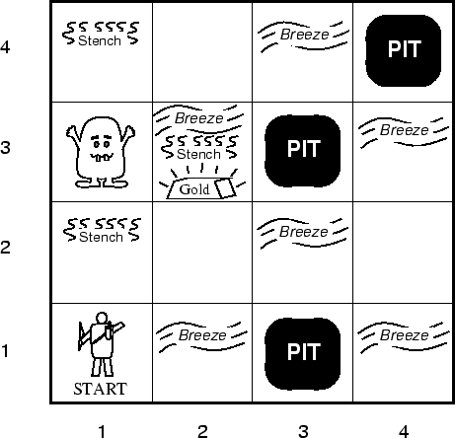
WW Agent Description
Performance measure
gold +1000, death -1000
-1 per step, -10 for using arrow
Environment
Squares adjacent to wumpus are smelly
Squares adjacent to pit are breezy
Glitter iff gold is in same square
Shooting kills wumpus if agent facing it
Shooting uses up only arrow
Grabbing picks up gold if in same square
Releasing drops gold in same square
Actuators
Left turn, right turn, forward, grab, release, shoot
Sensors
Breeze, glitter, smell, bump, scream

Slide 9
WW Environment Properties
Observable?
Partial
Deterministic?
Yes
Episodic?
Sequential
Static?
Yes (for now), wumpus and pits do not move
Discrete?
Yes
Single agent?
Multi (wumpus, eventually other agents)

Slide 10
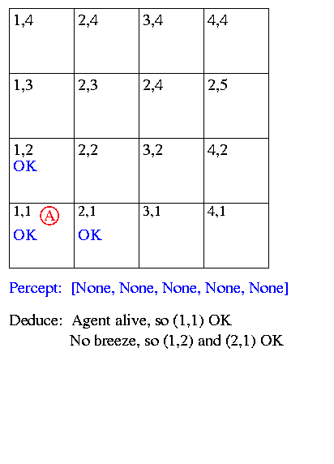
Sample Run

Slide 11
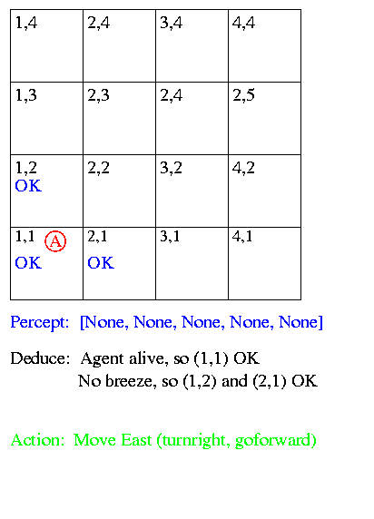
Sample Run

Slide 12
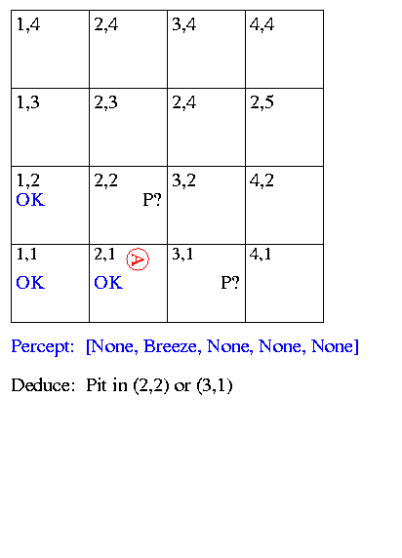
Sample Run

Slide 13
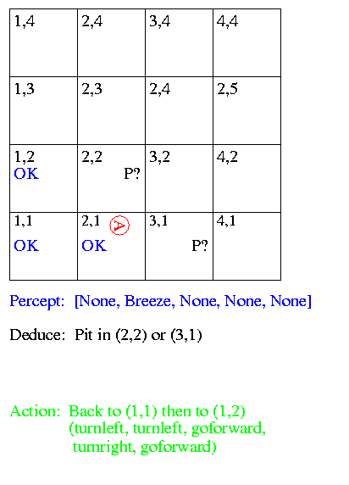
Sample Run

Slide 14
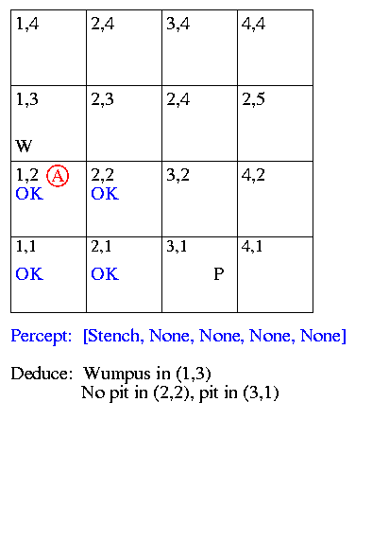
Sample Run

Slide 15
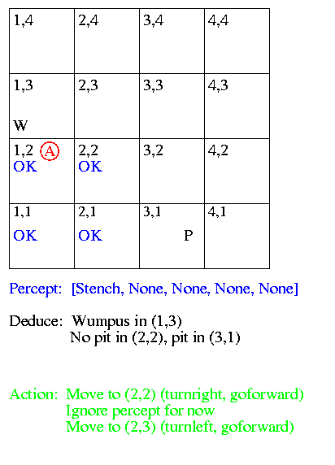
Sample Run

Slide 16
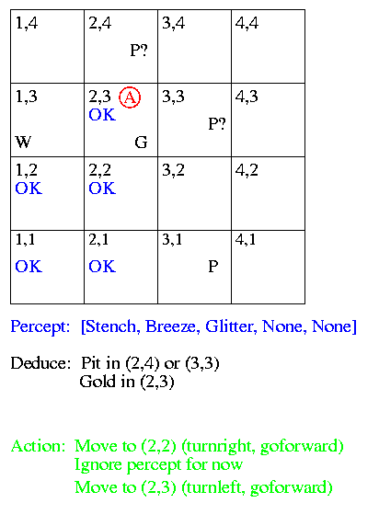
Sample Run

Slide 17
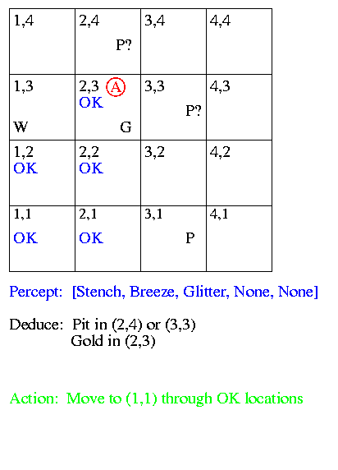
Sample Run

Slide 18
Sample Run
Now we look at
How to represent facts / beliefs
“There is a pit in (2,2) or (3,1)”
How to make inferences
“No breeze in (1,2), so pit in (3,1)”

Slide 19
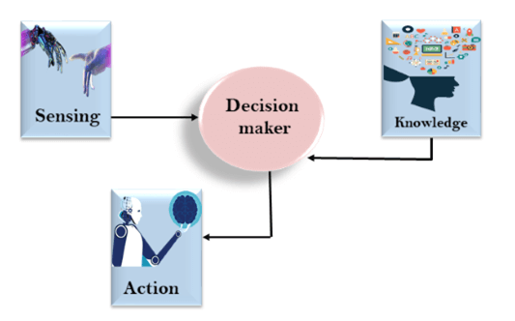
The relation between knowledge and intelligence
Knowledge of real-worlds plays a vital role creating artificial intelligence.
Knowledge plays an important role in demonstrating intelligent behavior in AI agents.
An agent is only able to accurately act on some input when he has some knowledge or experience about that input.
There is one decision maker which
act by sensing the environment
and using knowledge.
But if the knowledge part will not be
present then,
it cannot display intelligent behavior.

Slide 20
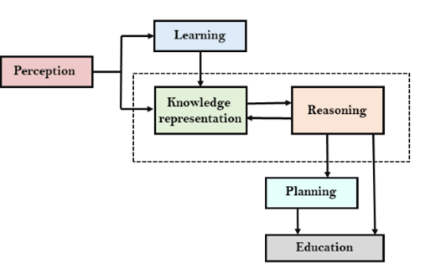
AI knowledge cycle
An Artificial intelligence system has the following components for displaying intelligent behavior:
1. Perception 2. Learning 3. Knowledge Representation
and Reasoning 4. Planning 5. Execution
Notes:
AI system has Perception component by which it retrieves information from its environment. It can be visual, audio or another form of sensory input.
The learning component is responsible for learning from data captured by Perception comportment.
In the complete cycle, the main components are knowledge representation and Reasoning. These two components are involved in showing the intelligence in machine-like humans. These two components are independent with each other but also coupled together. The planning and execution depend on analysis of Knowledge representation and reasoning.

Slide 21
Representation, Reasoning and Logic
Sentence: Individual piece of knowledge - English sentence forms one piece of knowledge in English language - Statement in C forms one piece of knowledge in C programming language
Syntax: Form used to represent sentences - Syntax of C indicates legal combinations of symbols - a = 2 + 3; is legal
- a = + 2 3 is not legal
- Syntax alone does not indicate meaning
Semantics: Mapping from sentences to facts in the world - They define the truth of a sentence in a “possible world” - Add the values of 2 and 3, store them in the memory location indicated by variable a
In the language of arithmetic:
x + 2 >= y is a sentence x2 + y > is not a sentence x + 2 >= y is true in all worlds where the number x + 2 is
no less than the number y x + 2 >= y is true in a world where
x = 7, y = 1 x + 2 >= y is false in a world where
x = 0, y = 6

Slide 22
Entailment
There can exist a relationship between items in the language
Sentences “entail” sentences (representation level)
Facts “follow” from facts (real world)
Entail / Follow mean the new item is true if the old items are true
A collection of sentences, or knowledge base (KB), entail a sentence
KB |= sentence
KB entails the sentence iff the sentence is true in all worlds where the KB is true
Entails
Sentences
Sentence
Semantics
Semantics
Representation
World
Follows
Facts
Fact

Slide 23
Entailment Examples
KB
The Giants won
The Reds won
Entails
Either the Giants won or the Reds won
KB
To get a perfect score your program must be turned in today
I always get perfect scores
Entails
I turned in my program today
KB
CookLectures -> TodayIsTuesday v TodayIsThursday
- TodayIsThursday
TodayIsSaturday -> SleepLate
Rainy -> GrassIsWet
CookLectures v TodayIsSaturday
- SleepLate
Which of these are correct entailments?
- Sleeplate
GrassIsWet
- SleepLate v GrassIsWet
TodayIsTuesday
True

Slide 24
Techniques of Knowledge Representation in AI
There are four major techniques out there that represent the knowledge in AI:
Logical representation
Semantic networks
Production rules
Frame representation

Slide 25
Logical Representation
Logical representation is the basic form of knowledge representation to the machines where a defined syntax with basic rules is used. This syntax has no ambiguity in the meaning and deals with prepositions. However, the logical form of knowledge representation acts as the communication rules. This is the reason it can be used to represent facts to the machines.
Logical representation is of two types:
Propositional Logic: Propositional logic is also known as statement logic or propositional calculus that works in a Boolean, which means a method of True or False.
First-order Logic: First-order logic also termed as First Order Predicate Calculus Logic (FOPL). This representation of logical knowledge represents the predicates and objects in quantifiers. It is an advanced model of propositional logic.

Slide 26
Semantic networks
A graphical representation, in this type of knowledge representation, carries the connected objects which are used with the data network. The semantic networks include arcs/edges (connections) and nodes/blocks (objects) that describe the connection between the objects.
The relationships in the semantic networks are of two types:
IS-A
KIND-OF
It is a more natural form of representation than logical due to its simplicity of understanding. The main downside of this form of representation is that it is computationally expensive and doesn’t include equivalent quantifiers that you can find in logical representation.

Slide 27
Production Rules
Production rules are the most common form of knowledge representation in AI systems. It is the simplest form of representing if-else rule-based systems and hence, can be understood easily. It represents a way of combining FOPL and propositional logic.
This system includes a set of rules, working memory, rule applier, and a recognized act cycle.
For every input, AI checks the conditions from the production rules, and after finding a better rule, it takes the needed action immediately. The cycle of selecting rules based on the conditions and acting to solve the issue is known as the recognition and act cycle that takes place in every input.
However, this method has some problems, such as inefficient execution due to the active rules and lack of gaining experience due to no storage of past results. Since the rules are expressed in natural language, the cost of the disadvantages can be redeemed. Here, rules can be changed and dropped easily if required.

Slide 28
Frame Representation
To understand the frame representation at a fundamental level, imagine a table consisting of names in columns and values in rows; the needed information is passed in this complete structure. In simple words, frame representation is a collection of values and attributes.
This is an AI-specific data structure that uses fillers (slot values that can be of any data type and shape) and slots. The process is quite similar to the typical Database Management System (DBMS). These fillers and slots form a structure called a frame.
The slots, in this form of knowledge representation, have names or attributes, and the knowledge related to the attributes is stored in fillers. The main advantage of this type of representation is that similar data can be merged into groups to divide the knowledge into structures. Further, it is divided into sub-structures.
Being like a typical data structure, this type can be understood, manipulated, and visualized easily. Typical concepts, including removing, deleting, and adding slots, can be carried out effortlessly.

Slide 29

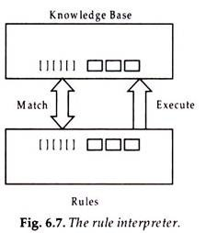
Production Rules
Rules are expressed as IF-THEN statements, as shown below:
1. If the pH of the spill is less than 6,
Then the spill material is an acid.
When the If portion of a rule is satisfied by the facts in the database, t
the action specified by the THEN in the database portion is performed.
When this happens the rule is said to fire or execute. A rule interpreter
compares the IF portions of rules with facts in the database and executes
the rule whose IF portion matches the facts.

Slide 30
Propositional Logic
It is the simplest form of logic where all the statements are made by propositions.
A proposition is a declarative statement which is either true or false.
It is a technique of knowledge representation in logical and mathematical form.
a) It is Sunday.
b) The Sun rises from West (False proposition)
c) 3+3= 7(False proposition)
d) 5 is a prime number.

Slide 31
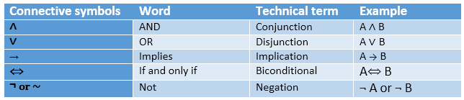
Logical Connectives:
Negation: A sentence such as ¬ P is called negation of P.
Conjunction: A sentence which has ∧ connective such as, P ∧ Q is called a conjunction. Example: Rohan is intelligent and hardworking. It can be written as, P= Rohan is intelligent, Q= Rohan is hardworking. → P∧ Q.
Disjunction: A sentence which has ∨ connective, such as P ∨ Q. is called disjunction, where P and Q are the propositions. Example: "Ritika is a doctor or Engineer", Here P= Ritika is Doctor. Q= Ritika is Engineer, so we can write it as P ∨ Q.
Implication: A sentence such as P → Q, is called an implication. Implications are also known as if-then rules. It can be represented as If it is raining, then the street is wet. Let P= It is raining, and Q= Street is wet, so it is represented as P → Q
Biconditional: A sentence such as P⇔ Q is a Biconditional sentence, example If I am breathing, then I am alive P= I am breathing, Q= I am alive, it can be represented as P ⇔ Q.

Slide 32
First Order Logic
PL is not sufficient to represent the complex sentences or natural language statements. The propositional logic has very limited expressive power. For eg: "Sachin likes cricket”
FOL is sufficiently expressive to represent the natural language statements in a concise way.
First-order logic is also known as Predicate logic or First-order predicate logic
First-order logic (like natural language) does not only assume that the world contains facts like propositional logic but also assumes the following things in the world:
Objects: A, B, people, numbers, colors, wars, theories, squares, pits, wumpus, ......
Relations: It can be unary relation such as: red, round, is adjacent, or n-any relation such as: the sister of, brother of, has color, comes between
Function: Father of, best friend, third inning of, end of

Slide 33
First Order Logic
As a natural language, first-order logic also has two main parts:
Syntax
Semantics
Constant | 1, 2, A, John, Mumbai, cat,....
Variables | x, y, z, a, b,....
Predicates | Brother, Father, >,....
Function | sqrt, LeftLegOf, ....
Connectives | ∧, ∨, ¬, ⇒, ⇔
Equality | ==
Quantifier | ∀, ∃
Example: Ravi and Ajay are brothers: => Brothers(Ravi, Ajay). Chinky is a cat: => cat (Chinky).
First-order logic statements can be divided into two parts:
Subject: Subject is the main part of the statement.
Predicate: A predicate can be defined as a relation, which binds two atoms together in a statement.
Consider the statement: "x is an integer.", it consists of two parts, the first part x is the subject of the statement and second part "is an integer," is known as a predicate.

Slide 34
Quantifiers in First-order logic:
A quantifier is a language element which generates quantification, and quantification specifies the quantity of specimen in the universe of discourse.
These are the symbols that permit to determine or identify the range and scope of the variable in the logical expression. There are two types of quantifier:
Universal Quantifier, (for all, everyone, everything)
Existential quantifier, (for some, at least one).
Universal Quantifier:
Universal quantifier is a symbol of logical representation, which specifies that the statement within its range is true for everything or every instance of a particular thing.
The Universal quantifier is represented by a symbol ∀, which resembles an inverted A.
Example:
All man drink coffee.
∀x man(x) → drink (x, coffee).
It will be read as: There are all x where x is a man who drink coffee.

Slide 35
Existential Quantifier:
Existential quantifiers are the type of quantifiers, which express that the statement within its scope is true for at least one instance of something.
It is denoted by the logical operator ∃, which resembles as inverted E. When it is used with a predicate variable then it is called as an existential quantifier.
Note: In Existential quantifier we always use AND or Conjunction symbol (∧).
If x is a variable, then existential quantifier will be ∃x or ∃(x). And it will be read as:
Example:
Some boys are intelligent.
∃x: boys(x) ∧ intelligent(x)
It will be read as: There are some x where x is a boy who is intelligent.

Slide 36
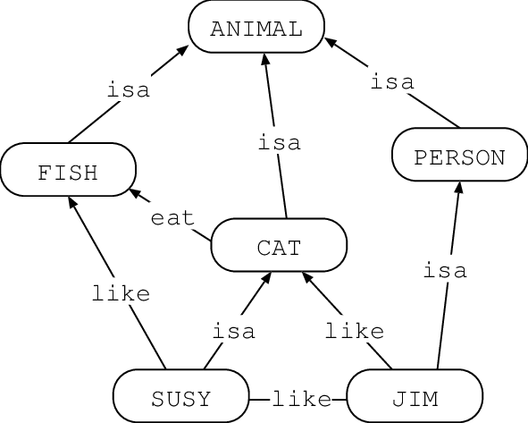
Semantic networks
These are graphical structures designed to represent and organize knowledge, enabling machines to understand and process information in human-readable form.
graphical structures designed to represent and organize knowledge, enabling machines to understand and process information in human-readable form.

Slide 37
Production Rules
Rules are expressed as IF-THEN statements, as shown below:
1. If the pH of the spill is less than 6,
Then the spill material is an acid.
When the If portion of a rule is satisfied by the facts in the database, t
the action specified by the THEN in the database portion is performed.
When this happens the rule is said to fire or execute. A rule interpreter
compares the IF portions of rules with facts in the database and executes
the rule whose IF portion matches the facts.

Slide 38
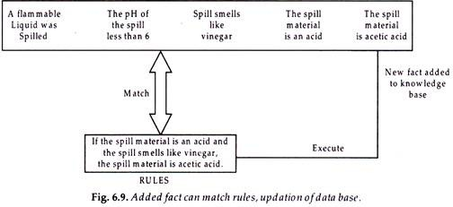
Production Rules
2. If the spill material is an acid and the spill smells like vinegar, then the spill material is acetic acid.
3. If a flammable liquid was spilled, then call the fire department.
These are rules which might exist in a crisis management problem, as it happened recently in Mumbai high waters, for containing oil and chemical spills.
The rule’s action part may modify the set of facts in the knowledge base by adding the then portion of the rule fired in the data base added as new fact:

Slide 39
Fuzzy Logic
The 'Fuzzy' means that the things are not clear or are vague.
Sometimes, we cannot decide in real life that the given problem or statement is either true or false. It provides many values between the true and false.
For Eg: Is it hot weather? One answer can be True (1) or False (0) and Another answer can be : Very Much (0.9), not much (0.4), very less (0.1)
This concept was introduced by Lofti Zadeh in 1965 based on the Fuzzy Set Theory.

Slide 40
Characteristics of Fuzzy Logic
This concept is flexible and we can easily understand and implement it.
It is used for helping the minimization of the logics created by the human.
It is the best method for finding the solution of those problems which are suitable for approximate or uncertain reasoning.
It always offers two values, which denote the two possible solutions for a problem and statement.
It allows users to build or create the functions which are non-linear of arbitrary complexity.
In fuzzy logic, everything is a matter of degree.
In the Fuzzy logic, any system which is logical can be easily fuzzified.
It is based on natural language processing.
It is also used by the quantitative analysts for improving their algorithm's execution.
It also allows users to integrate with the programming.

Slide 41
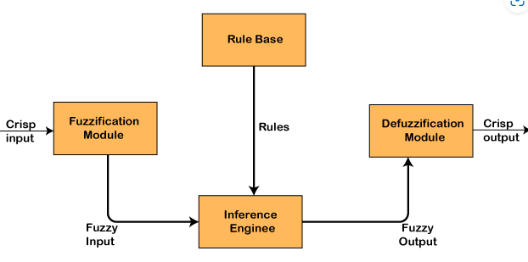
Architecture of a Fuzzy Logic System
The architecture consists of four components:
Rule Base
Fuzzification
Inference Engine
Defuzzification

Slide 42
Description of the components:
1. Rule Base
Rule Base is used for storing the set of rules and the If-Then conditions given by the experts are used for controlling the decision-making systems.
2. Fuzzification
Fuzzification is a module for transforming the system inputs, i.e., it converts the crisp number into fuzzy steps. The crisp numbers are those inputs which are measured by the sensors and then fuzzification passed them into the control systems for further processing. This component divides the input signals into following five states in any Fuzzy Logic system:
Large Positive (LP)
Medium Positive (MP)
Small (S)
Medium Negative (MN)
Large negative (LN)

Slide 43
Description of the components:
3. Inference Engine
This component is a main component in any Fuzzy Logic system (FLS), because all the information is processed in the Inference Engine. It allows users to find the matching degree between the current fuzzy input and the rules. After the matching degree, this system determines which rule is to be added according to the given input field. When all rules are fired, then they are combined for developing the control actions.
4. Defuzzification
Defuzzification is a module or component, which takes the fuzzy set inputs generated by the Inference Engine, and then transforms them into a crisp value. It is the last step in the process of a fuzzy logic system. The crisp value is a type of value which is acceptable by the user.

Slide 44
Membership Function
The membership function is a function which represents the graph of fuzzy sets, and allows users to quantify the linguistic term. It is a graph which is used for mapping each element of x to the value between 0 and 1.
This function is also known as indicator or characteristics function.
This function of Membership was introduced in the first papers of fuzzy set by Zadeh.
For the Fuzzy set B, the membership function for X is defined as:
μB:X → [0,1]
In this function X, each element of set B is mapped to the value between 0 and 1. This is called a degree of membership or membership value.

Slide 45
Classical Set Theory vs Fuzzy Set Theory
Classical Set Theory | Fuzzy Set Theory
1. This theory is a class of those sets having sharp boundaries. | 1. This theory is a class of those sets having un-sharp boundaries.
2. This set theory is defined by exact boundaries only 0 and 1. | 2. This set theory is defined by ambiguous boundaries.
3. In this theory, there is no uncertainty about the boundary's location of a set. | 3. In this theory, there always exists uncertainty about the boundary's location of a set.
4. This theory is widely used in the design of digital systems. | 4. It is mainly used for fuzzy controllers.

Slide 46

Fuzzy Set
The set theory of classical is the subset of Fuzzy set theory.
Fuzzy logic is based on this theory, which is a generalisation of the classical theory of set (i.e., crisp set) introduced by Zadeh in 1965.
A fuzzy set is a collection of values which exist between 0 and 1. Fuzzy sets are denoted or represented by the tilde (~) character.
In the fuzzy set, the partial membership also exists. This theory released as an extension of classical set theory.
This theory is denoted mathematically as A fuzzy set (Ã) is a pair of U and M, where U is the Universe of discourse and M is the membership function which takes on values in the interval [ 0, 1 ]. The universe of discourse (U) is also denoted by Ω or X.

Slide 47

Operations on Fuzzy Set
μ_{Ā}(x) = 1-μ_{A}(x),
Given Ã and B are the two fuzzy sets, and X be the universe of discourse with the following respective member functions:
1. Union Operation: μA∪B(x) = max (μA(x), μB(x))
Eg: A = {( X₁, 0.6 ), (X₂, 0.2), (X₃, 1), (X₄, 0.4)}
B = {( X₁, 0.1), (X₂, 0.8), (X₃, 0), (X₄, 0.9)},
Then, AUB = {( X₁, 0.6), (X₂, 0.8), (X₃, 1), (X₄, 0.9)}
2. Intersection Operation: μA∩B(x) = min (μA(x), μB(x))
Eg: A = {( X₁, 0.6 ), (X₂, 0.2), (X₃, 1), (X₄, 0.4)}
B = {( X₁, 0.1), (X₂, 0.8), (X₃, 0), (X₄, 0.9)},
Then, A∩B == {( X1, 0.1), (X2, 0.2), (X3, 0), (X4, 0.4)}
3. Complement Operation:μĀ(x) = 1-μA(x)
Eg: A = {( X₁, 0.3 ), (X₂, 0.8), (X₃, 0.5), (X₄, 0.1)}
Then, Ā= {( X1, 0.7 ), (X2, 0.2), (X3, 0.5), (X4, 0.9)}

Slide 48
Applications of Fuzzy Logic
It is used in Businesses for decision-making support system.
It is used in Automative systems for controlling the traffic and speed, and for improving the efficiency of automatic transmissions. Automative systems also use the shift scheduling method for automatic transmissions.
This concept is also used in the Defence in various areas. Defence mainly uses the Fuzzy logic systems for underwater target recognition and the automatic target recognition of thermal infrared images.
It is also widely used in the Pattern Recognition and Classification in the form of Fuzzy logic-based recognition and handwriting recognition. It is also used in the searching of fuzzy images.
Fuzzy logic systems also used in Securities.
It is also used in microwave oven for setting the lunes power and cooking strategy.
This technique is also used in the area of modern control systems such as expert systems.
Finance is also another application where this concept is used for predicting the stock market, and for managing the funds.
It is also used for controlling the brakes.
It is also used in the industries of chemicals for controlling the ph, and chemical distillation process.
It is also used in the industries of manufacturing for the optimization of milk and cheese production.
It is also used in the vacuum cleaners, and the timings of washing machines.
It is also used in heaters, air conditioners, and humidifiers.

Slide 49
THANK YOU!

